Slide 1
Wine Quality
Technical Preview
February 2022
Produced by George Lee

Slide 2
Objective
Quality of wine can be a highly subjective rating. The dataset contains physiochemical properties of wine with the quality rating as its target vector quality to determine if there is any science behind wine quality.
Overview
Data Cleansing
Missing values
Duplicate values
Outliers
Exploratory Visualizations
Bar charts
Correlation heatmap

Slide 3
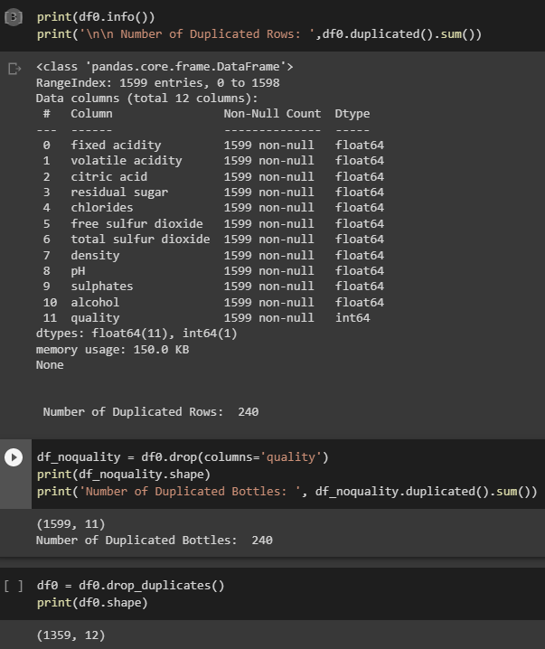
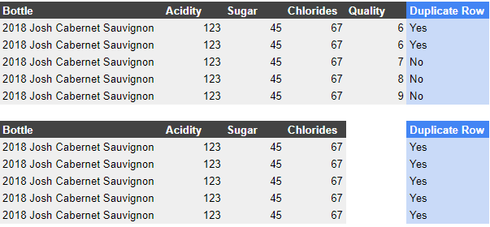
Missing Values and Duplicate Data
Code to:
Identify missing/null values
Identify duplicate rows
Decision on handling duplicate values
Confirm Duplicate Rows have Different Quality Scores

Slide 4
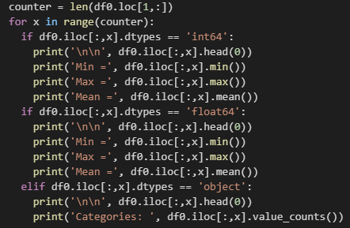


Outliers
Challenges
Function to identify outliers
Potential Outliers:
Free Sulfur Dioxide
Total Sulfur Dioxide

Slide 5
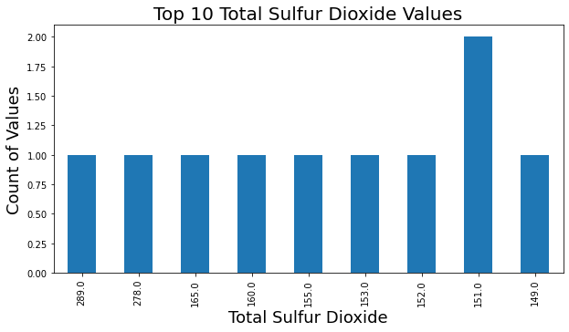
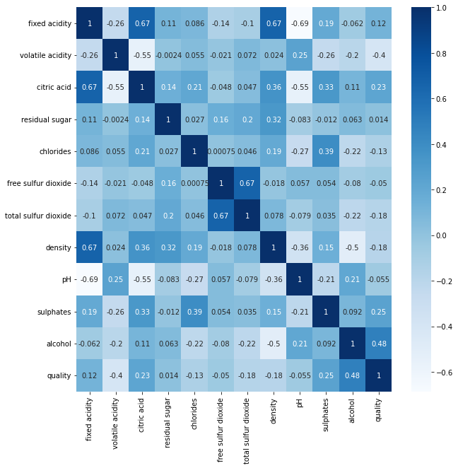
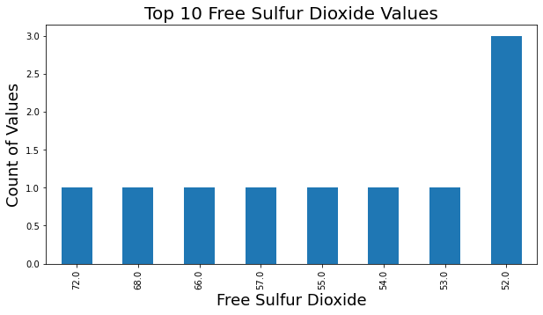
Exploratory Visualizations
Correlation Heatmap

